Slide 1


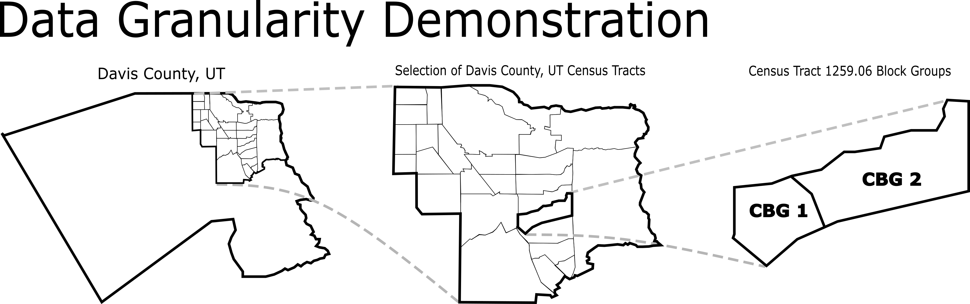
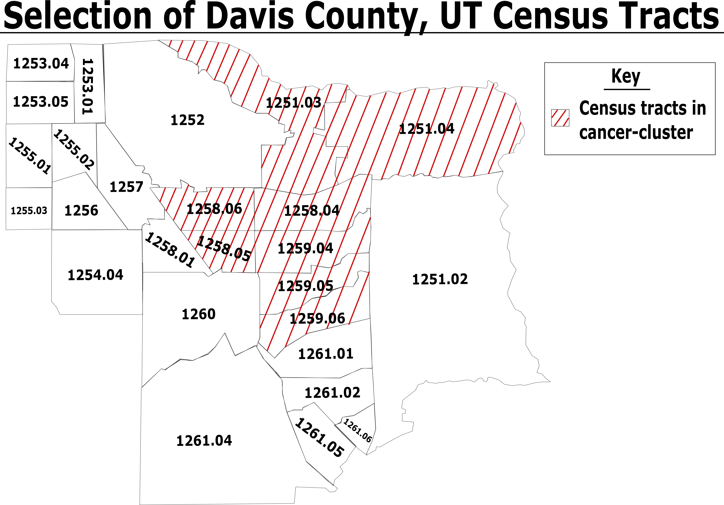

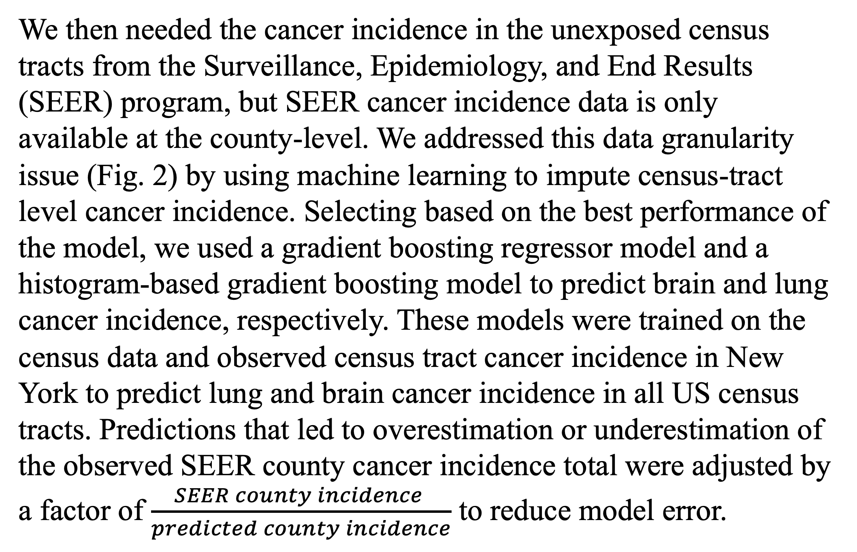
Applications of Causal Inference Concepts and Machine Learning Methods to Investigate Cancer Clusters
John L. Maddox¹ & Ashley E. Rice Ph. D.²
¹University of Tennessee, Knoxville, TN 37996, ²Oak Ridge National Laboratory, Oak Ridge, TN 37830
Contact: lmaddox5@utk.edu, riceae@ornl.gov
Introduction
Materials and Methods
Results
Identifying the cause of significant localized increases in populational cancer incidence, or cancer clusters, remains a vital public health issue. A ratio between observed and expected incidence of community cancer called the Standardized Incidence Ratio (SIR) is used to confirm the community-reported high cancer incidence as a cancer cluster. Only then, are possible environmental causes analyzed, which restricts SIR to considering regions of interest independently of exposure and fails to determine the causal role of most environmental factors [1]. Using an improved metric called the causal SIR (cSIR), we calculate the ratio between the observed cancer incidence in an exposed region and a covariate-matched unexposed region [2]. By integrating exposure into the diagnostic ratio, causal links between exposure and increased cancer incidence are made statistically sound. Improving the results of cancer cluster studies necessitates the implementation of cSIR.
Data Name | Number of Records | Data Granularity
SEER Cancer Incidence | 1,085 counties | County
Census Data | 65,444 Census Tracts | Census Tract
TRI Dioxin Exposure | 1,572 Census Tracts | Census Tract
NY Cancer Incidence | 4,603 Census Tracts | Census Tract
Census-Tract | cSIR (Brain, Lung)
1251.03 | (0.19, 0.90)
1251.04 | (0.17, 0.68)
1258.04 | (0.21, 0.67)
1258.05 | (0.21, 0.77)
Census-Tract | cSIR (Brain, Lung)
1258.06 | (0.63, 1.38)
1259.04 | (0.46, 1.59)
1259.05 | (0.46, 1.27)
1259.06 | (0.27, 1.10)
Table 1: Data gathered to calculate the cSIR with their respective sizes and granularity.
Table2: cSIR scores for each Davis County, UT census-tracts.
To begin, we compiled census data, superfund site data, and Toxic Release Inventory (TRI) dioxin exposure on all census tracts in the US (Table 1). After removing dioxin-exposed census tracts, we used a 10:1 minimum Mahalanobis distance matching to find multiple unexposed census tracts that were similar in socioeconomic and demographic covariates. These covariates included percentage below the poverty line, percentage with a high school degree, race, sex, and career industry (Fig. 3). Matching provided the unexposed regions, or counterfactual group, to calculate the cSIR for both brain and lung cancer incidence in each exposed census-tract.
The gradient boosting regressor model used to impute the cancer incidence data had an R² value of 0.25 for brain cancer and the histogram-based gradient boosting regressor model 0.65 for lung cancer incidence. Both performed well in predicting cancer incidence according to the SEER data. In our cSIR evaluation, we found that four out of eight census tracts had a cSIR value above 1.0 for brain cancer incidence and zero out of eight had a cSIR value above 1.0 for lung cancer incidence. While the causal link must be confirmed by future research, the cSIR scores support dioxin’s potential causal role for the brain cancer cluster.
t
Data Granularity Demonstration
Problem Statement
We used the cSIR to reevaluate the conclusions of an identified brain and lung cancer cluster (Fig.1) from 1997-2003 in which investigation which found no causal link between the increased cancer incidence and local dioxin exposure.
Figure 2: Different dataset granularities required us to transform block group-level and county-level data into census tract-level granularity.
We then needed the cancer incidence in the unexposed census tracts from the Surveillance, Epidemiology, and End Results (SEER) program, but SEER cancer incidence data is only available at the county-level. We addressed this data granularity issue (Fig. 2) by using machine learning to impute census-tract level cancer incidence. Selecting based on the best performance of the model, we used a gradient boosting regressor model and a histogram-based gradient boosting model to predict brain and lung cancer incidence, respectively. These models were trained on the census data and observed census tract cancer incidence in New York to predict lung and brain cancer incidence in all US census tracts. Predictions that led to overestimation or underestimation of the observed SEER county cancer incidence total were adjusted by a factor of $\frac{SEER county incidence }{predicted county incidence}$ to reduce model error.
Causality Criteria
t
Strength of Association
Consistency of Data
Specificity
Temporality
Dose-response
Biological Plausibility
Coherence
Experimental Evidence
Analogy
Figure 3: Differences in the implementation of SIR and cSIR. SIR finds cancer clusters before exposure, while cSIR finds exposure before the cancer cluster
Conclusion
It is imperative that possible environmental causes behind cancer clusters identified by communities and later confirmed through rigorous mathematical analyses are thoroughly investigated. Cancer cluster investigations should produce valuable information that determines the safety of extended living in exposed communities. To ensure cancer cluster investigations produce statistically valid results, widespread application of the cSIR is vital.
Figure 1: Selection of the eight Davis County, Utah census tracts containing both the confirmed brain and lung cancer cluster we are reinvestigating.
References:
Goodman, M., Naiman, J. S., Goodman, D., & LaKind, J. S. (2012). Cancer clusters in the USA: what do the last twenty years of state and federal investigations tell us?. Critical reviews in toxicology, 42(6), 474–490. https://doi.org/10.3109/10408444.2012.675315
Nethery, R. C., Yang, Y., Brown, A. J., & Dominici, F. (2020). A causal inference framework for cancer cluster investigations using publicly available data. Journal of the Royal Statistical Society. Series A, (Statistics in Society), 183(3), 1253–1272. https://doi.org/10.1111/rssa.12567
This work was supported in part by the U.S. Department of Energy, Office of Science, Office of Workforce Development for Teachers and Scientists (WDTS) under the Science Undergraduate Laboratory Internships program.
This manuscript has been co-authored by UT-Battelle, LLC, under contract DE-AC05-00OR22725 with the US Department of Energy (DOE). The US government retains and the publisher, by accepting the article for publication, acknowledges that the US government retains a nonexclusive, paid-up, irrevocable, worldwide license to publish or reproduce the published form of this manuscript, or allow others to do so, for US government purposes. DOE will provide public access to these results of federally sponsored research in accordance with the DOE Public Access Plan (http://energy.gov/downloads/doe-public-access-plan).

